Slide 1
AI Study Buddy – Week 2
Team Project - MSc Computer Science
Rumaysa Babulkhair – D24125711 (Team Lead)
Anika Mayesha – D24125187
Lorenzo Palleschi – D24126922
Yurii Sykal – C23512523

Slide 2



Personas
• Semi-fictional way for us to represent various student types.
• Makes the target users more relatable and human.
• Great for highlighting pain points and frustrations
• Helps to prioritise features and support.

Slide 3
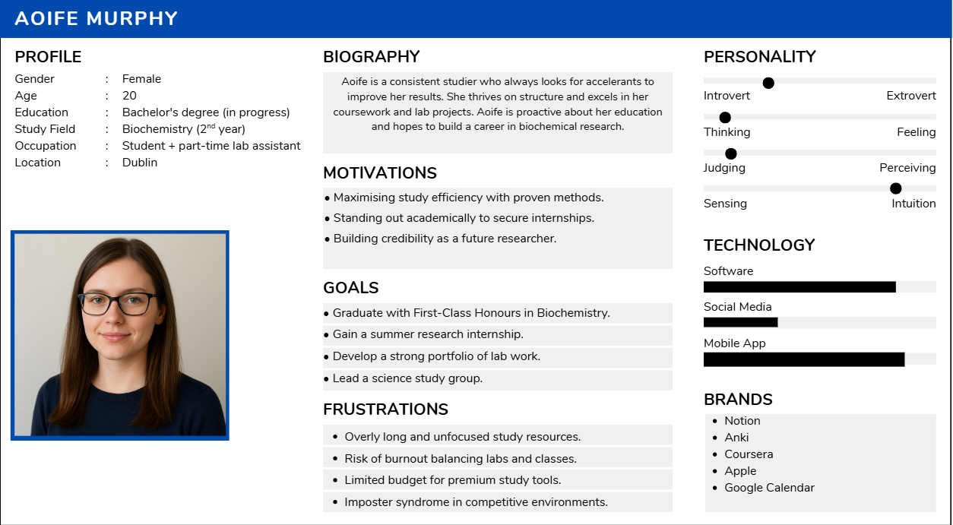
Persona 1 – The Consistent Studier

Slide 4
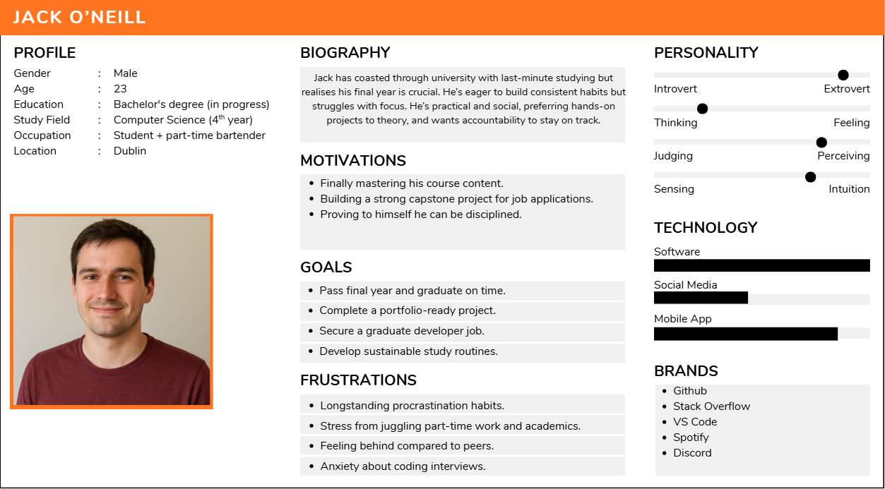
Persona 2 – 4th Year Coaster

Slide 5
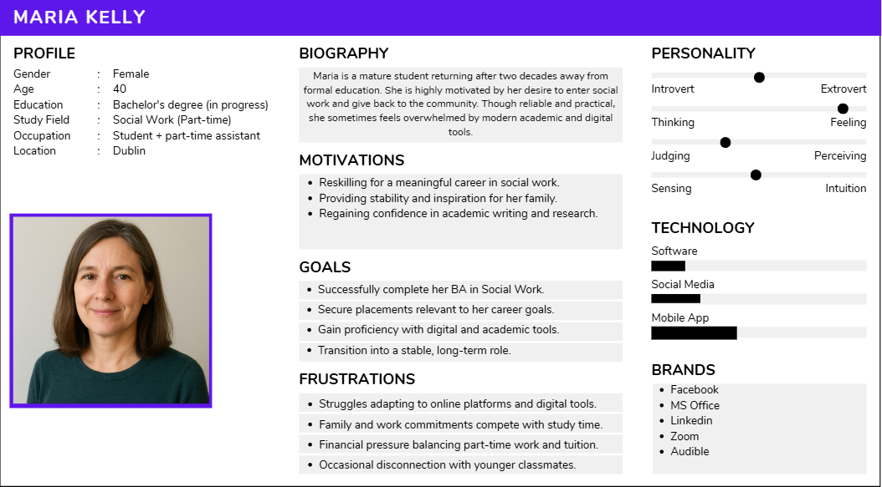
Persona 3 – Mature Student

Slide 6
AI in Education Research
Basis of Study: Review of 8 research papers
6 focused on universities
2 focused on schools
Key Areas Explored:
Benefits of AI in education
Challenges & limitations in adoption
Factors influencing adoption

Slide 7
Benefits of AI in Education
Chatbots improve task efficiency and access to resources.
Students prefer personalized support and real-time feedback.
IMAN Vocab App boosts vocabulary with real-time object recognition.
AI supports self-regulated learning and goal management.
Mobile apps enable flexible, anytime learning

Slide 8
Student Perceptions and Adoption
Social norms influence AI adoption.
Adoption influenced by gender, academic level, and field of study.
Concerns about AI replacing traditional teaching.
Students value cognitive support but miss motivational aid.
Gender differences in AI concerns

Slide 9
Challenges and Limitations
Ethical concerns: Plagiarism and over-reliance on AI
Chatbots improve efficiency but have limited academic impact
Rural students face internet and digital literacy barriers
Bias in AI tools affects fairness
AI lacks emotional intelligence for deeper engagement

Slide 10
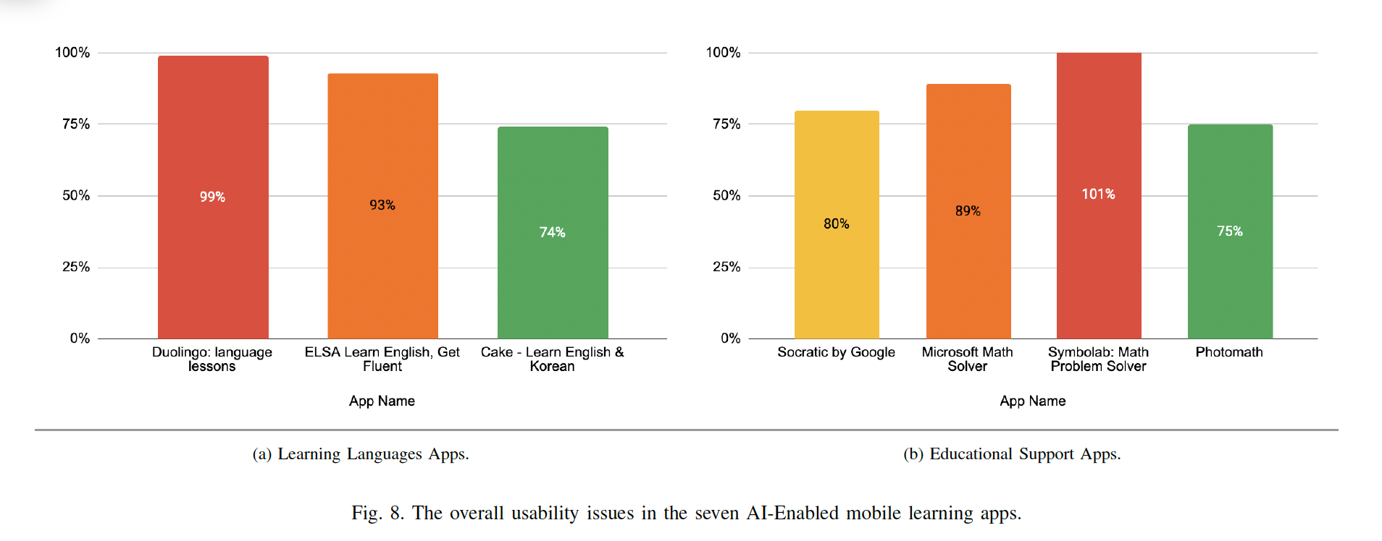
Issues in educational AI apps
Language apps: Uses voice recognition and prompts
Math based AI apps: Uses Image recognition and prompts

Slide 11
“the app became unstable, and AI doesn’t care about recognizing anything. You can sing a song instead of the correct answer, and AI will accept it. Most of the time, it freezes in the middle of the lesson, and the mic button gets stuck, among other issues. Don’t buy their plan until they fix their app.” – voice recognition
AI App Reviews
“It was a good tool to start learning a new language from scratch. But I find that the AI component doesn’t work very well. It gives easy exercises for the same word right after I’ve already done a more challenging one. Also, I have to practice a lot of unnecessary stuff like names and cities. A lot of practices are highly redundant, so I think I waste a lot of time practicing easy and unnecessary stuff. Furthermore, I have no choice in what to practice. All in all, it’s not the most efficient.” English learning app
“This app is complete literal trash It cant even recognize an extremely simple variable equation system properly much less solve it Leave the image recognition to the big boys like Google and Microsoft, You’re an embarrassment to society and to yourselves.” – Image recognition
“As long as this app does not solve the Gau Algorithm, it is worthless for me.
Can’t read matrix integrals or equations with more than one variable. Total trash.”
- Image recognition

Slide 12

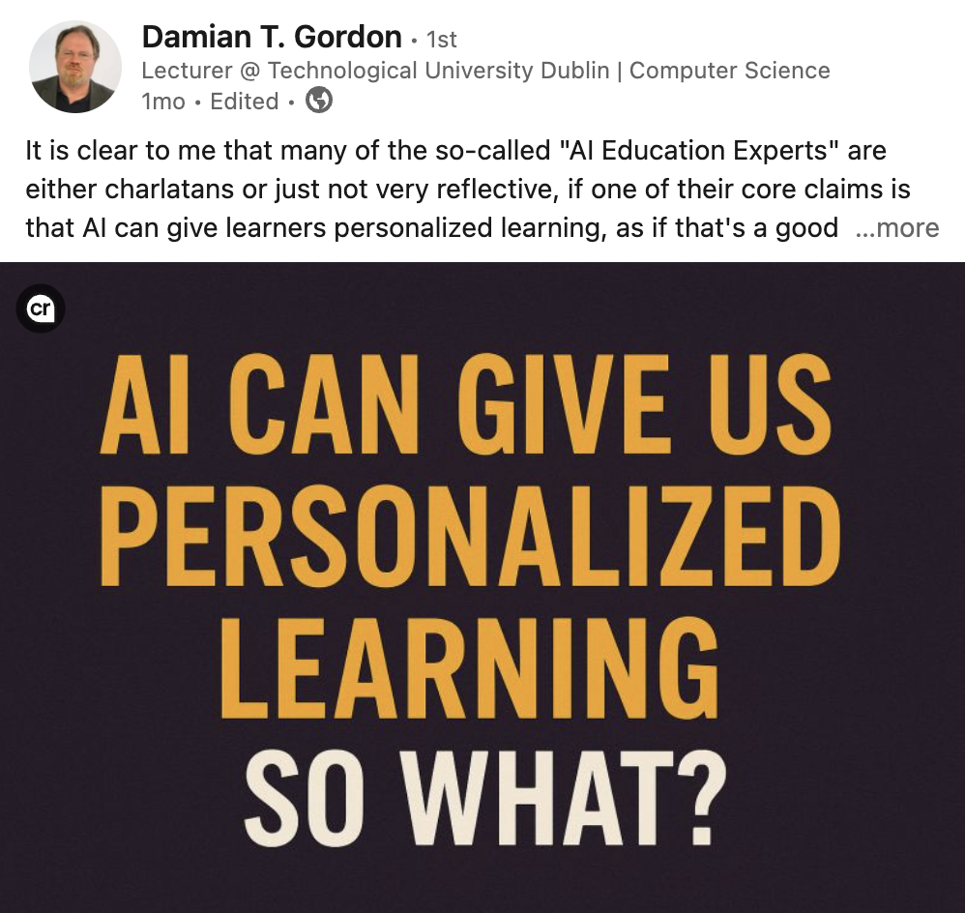
Teachers
Opinion

Slide 13
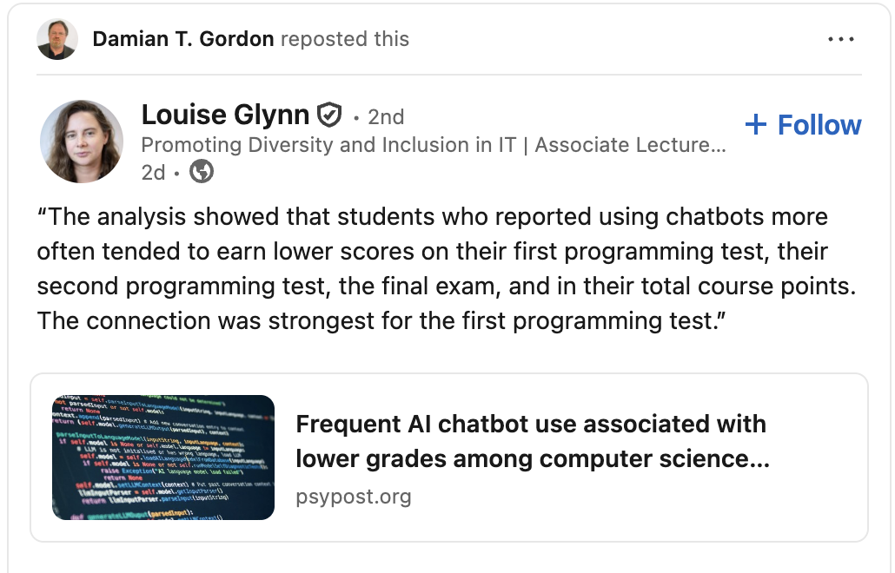
Teachers
Opinion

Slide 14
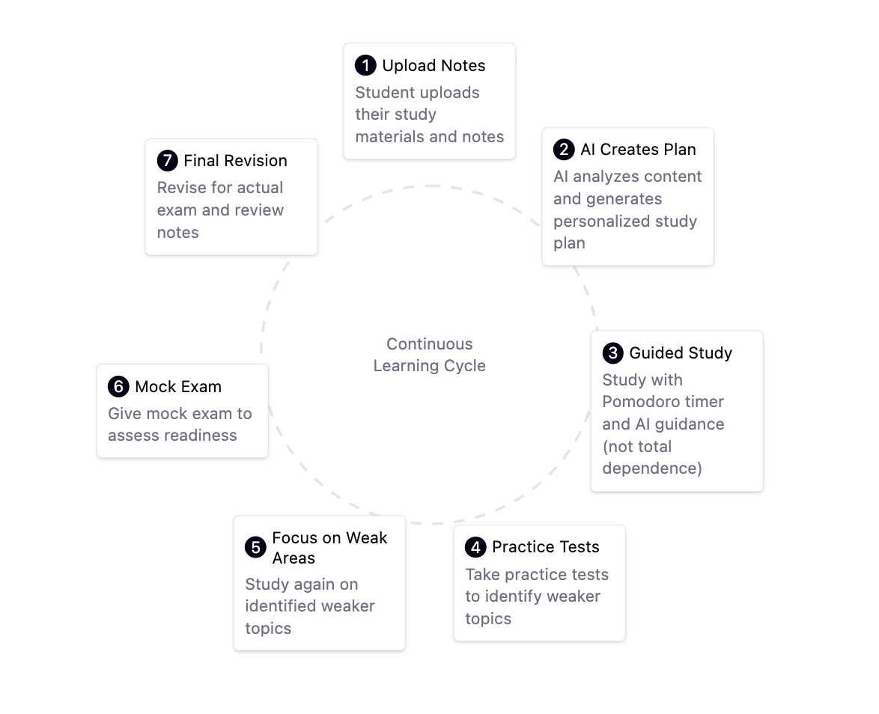
Solution: Study Buddy

Slide 15
Use-Case (Figma)
This use-case shows how a student would interact with the current iteration of AI Study Buddy.
Figma allows us to visualise our thought process and allows for substantially easier and accurate prototypes to be created.
With a step-through of the journey, design choices and features are easier to understand before development.

Slide 16
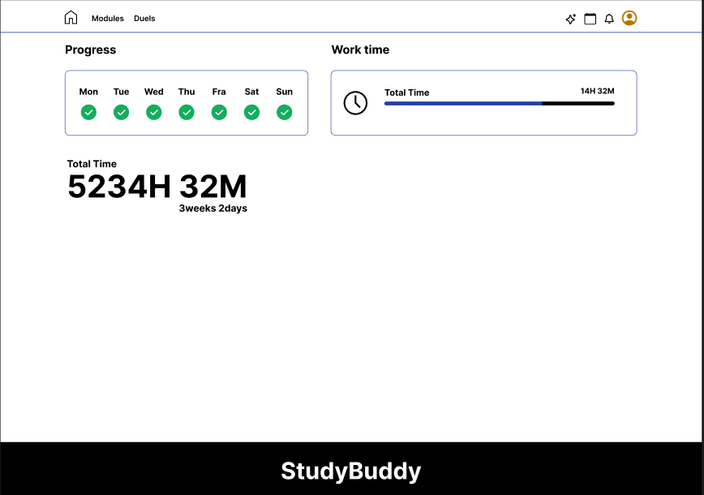
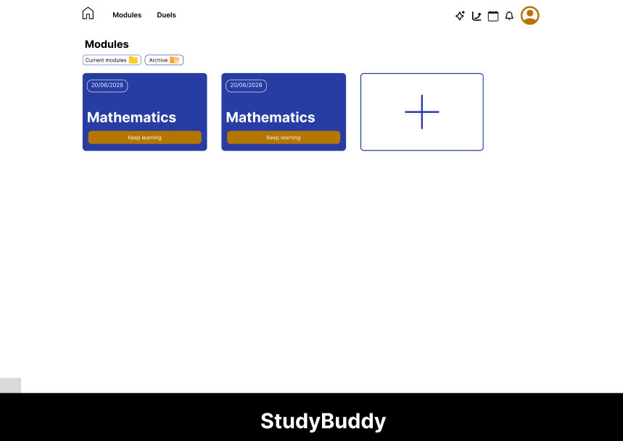
Homepage and Modules

Slide 17
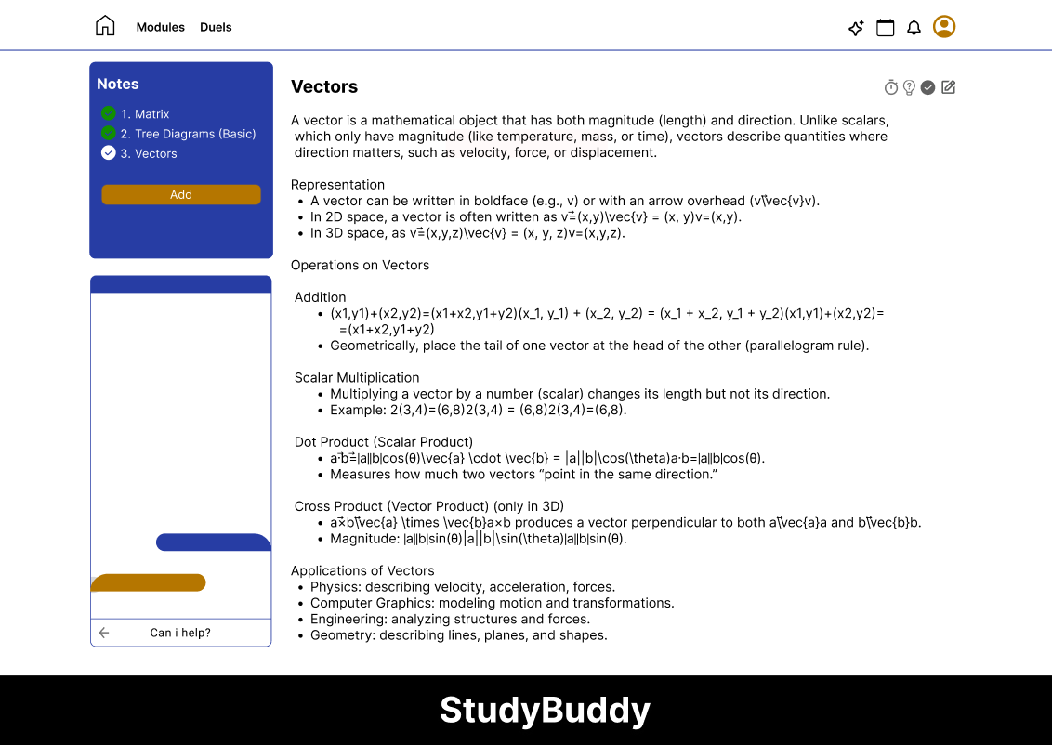
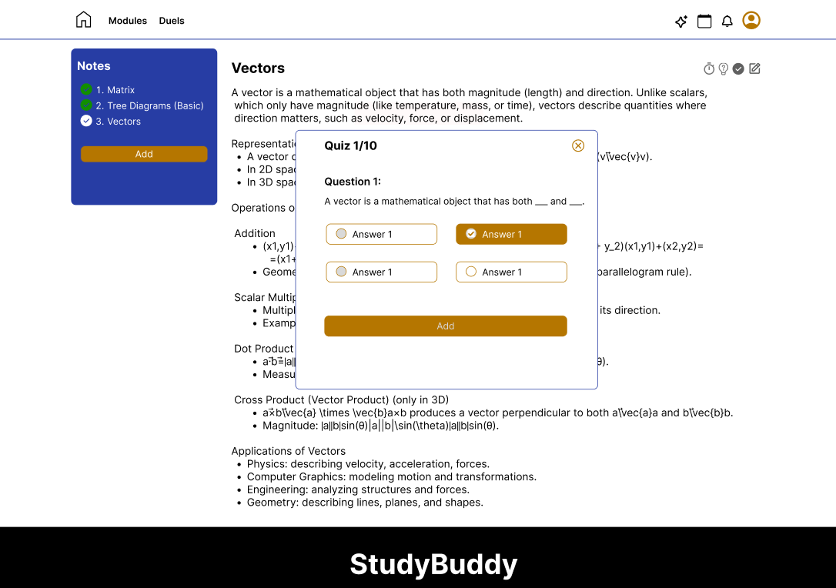
Mathematics and Quizzing

Slide 18
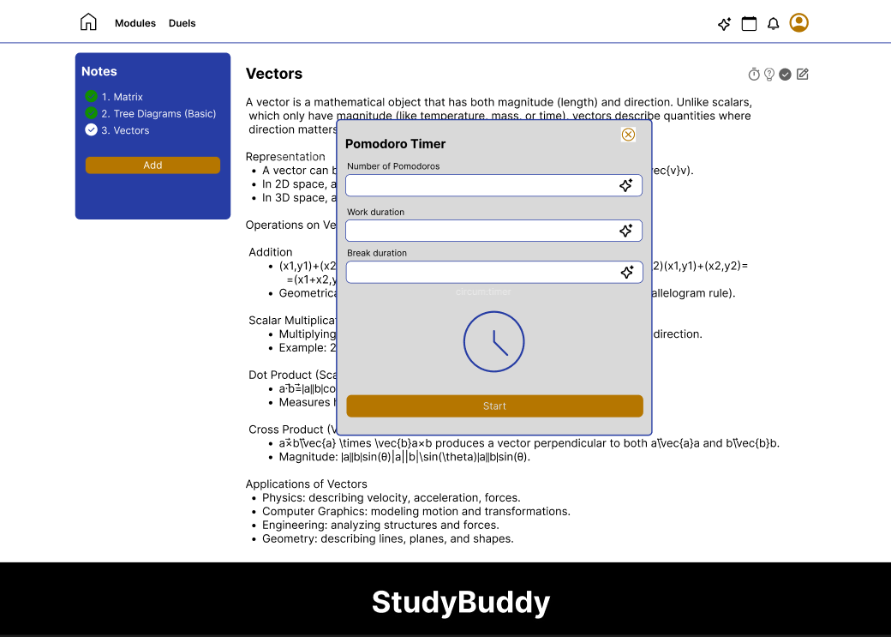
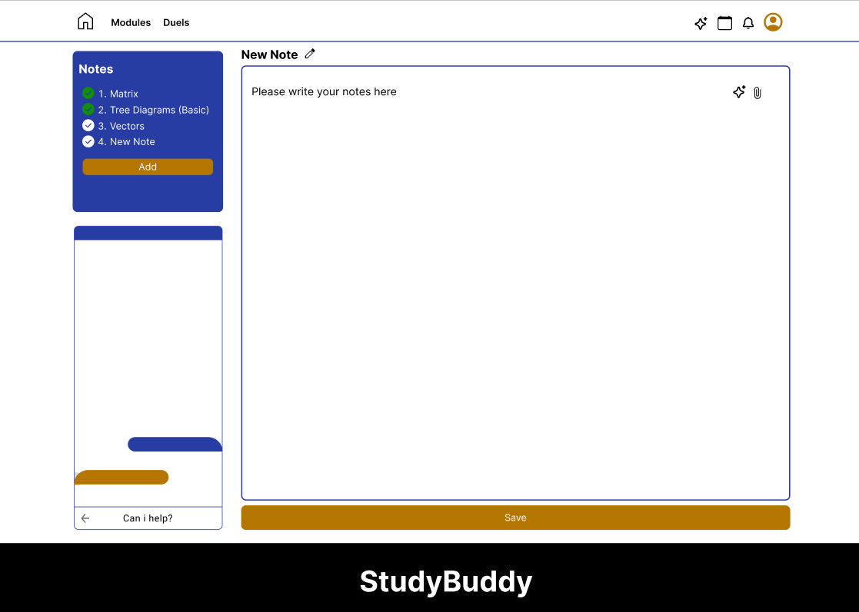
Pomodoro and Notes

Slide 19
REferences
Alsanousi, B., Abdulmohsen, A. S., & Do, H. (2023). Investigating the User Experience and Evaluating Usability Issues in AI-Enabled Learning Mobile Apps: An Analysis of User Reviews.
Jin, S.‑H., Im, K., Roll, I., & Seo, K. (2023). Supporting students’ self-regulated learning in online learning using artificial intelligence applications.
Lai , C.-L. (2021). Exploring University Students’ Preferences for AI-Assisted Learning Environment: A Drawing Analysis with Activity Theory Framework.
Mahendra, M., Nurkamilah, N., & Sari, C. (2023). Artificial-Intelligence powered App as learning aid in improving learning autonomy: Students’ perspective .
Rahman , M., Hossain , M., Ismail , N., Hossen, M., & Sultana, M. (2025). Determinants of students’ adoption of AI chatbots in higher education: the moderating role of tech readiness.
Rehman, M., Ismail, N., Hossen, M., & Hossain, M. (2025). Students’ mindset to adopt AI chatbots for effectiveness of online learning in higher education.

Slide 20
REferences
Stohr, C., Ou, A., & Malmstr¨ , H. (2024). Perceptions and usage of AI chatbots among students in higher education across genders, academic levels and fields of study.
Damian T. Gordon, LinkedIn, Retrived September 30,2025, from https://www.linkedin.com/posts/damiangordon_it-is-clear-to-me-that-many-of-the-so-called-activity-7360342318572290048-WSrn?utm_source=social_share_send&utm_medium=member_desktop_web&rcm=ACoAADd0OCQBJWxU0U7mnSEBNptZD1UKEu0wkps
Damian T. Gordon, LinkedIn, Retrived September 30,2025, from https://www.linkedin.com/posts/louise-glynn-80576619_frequent-ai-chatbot-use-associated-with-lower-activity-7377845191094865920-yMlW?utm_source=social_share_send&utm_medium=member_desktop_web&rcm=ACoAADd0OCQBJWxU0U7mnSEBNptZD1UKEu0wkps

Slide 21
Thank You
Any Questions?

